Slide 1
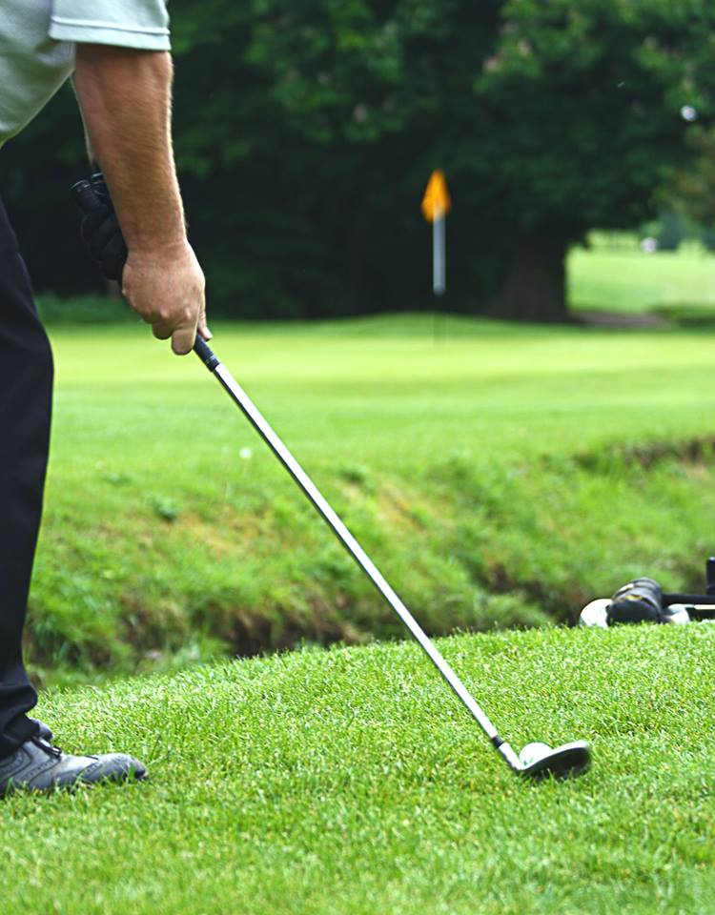
G LF
Join Us For a Round
Date
Time
Place
04 July 2019
12h00 Shotgun Start
George Golf Club
Langenhoven St
Entry Fee: R575 per player
Includes: Green Fees, Halfway House Meal & Spitbraai Dinner during Prize Giving
Entries close 27th June 2019
Fabulous Prizes to be won!
Bookings with Kerryn
kzn@ksa.co.za
082 721 5314

